Slide 1
ELEMENTARY STATISTICS, BLUMAN
TI Graphing Calculator – Construct a Histogram
© 2019 McGraw-Hill Education. All rights reserved. Authorized only for instructor use in the classroom. No reproduction or further distribution permitted without the prior written consent of McGraw-Hill Education.

Slide 2
Objectives for this PowerPoint
Construct a Histogram using the TI Graphing Calculator

Slide 3
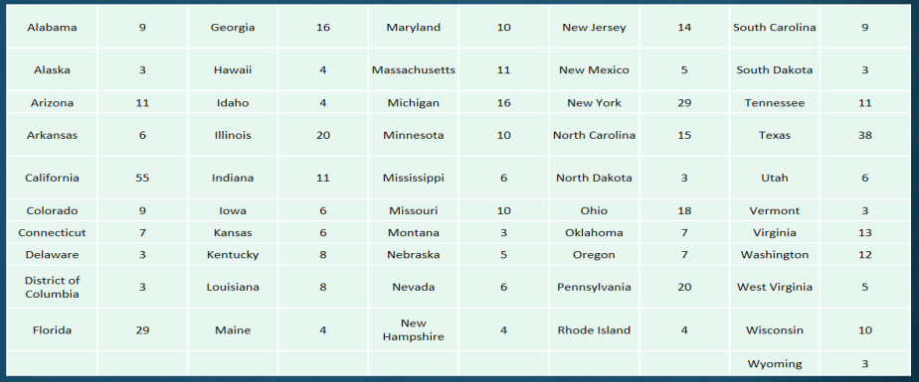
Data
In a previous series of videos we used the data for the number of United States Electoral College members allocated to each state as of the 2016 US presidential election in order to learn how to construct a grouped frequency distribution and then a histogram.
Jump to long description

Slide 4
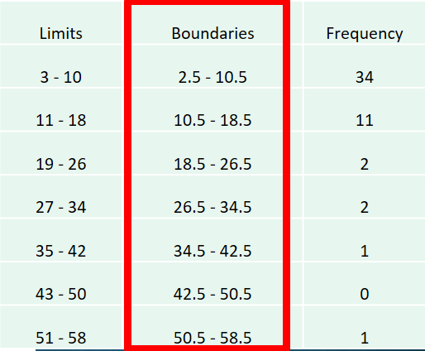
Class Width and Boundaries
In order to do this we will need the data set and in order to ensure that the histogram that is generated by the TI graphing calculator matches the one that we constructed by hand. We will need the class boundaries and the class width.
From previous video:
Class Width = 8

Slide 5
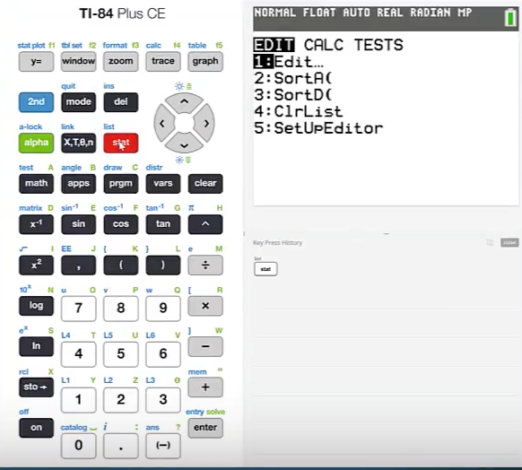
Histogram (1)
Press stat

Slide 6
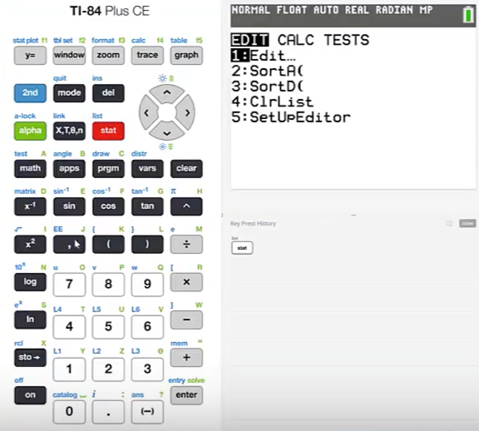
Histogram (2)
Press 1:

Slide 7
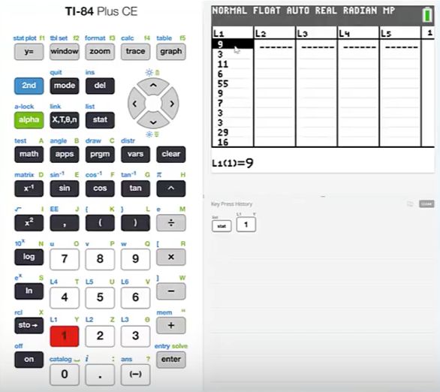
Histogram (3)
Enter the data into a List. Here the data have been entered into List 1

Slide 8
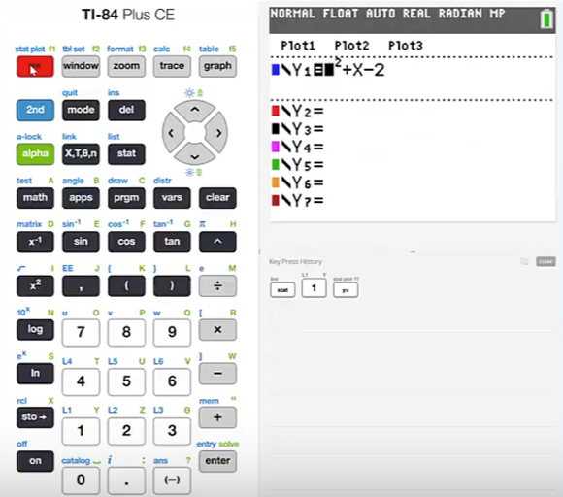
Histogram (4)
Press y=
Make sure all functions entered there are turned off. They can be turned off using the cursor to highlight the equals sign and then pressing enter.

Slide 9
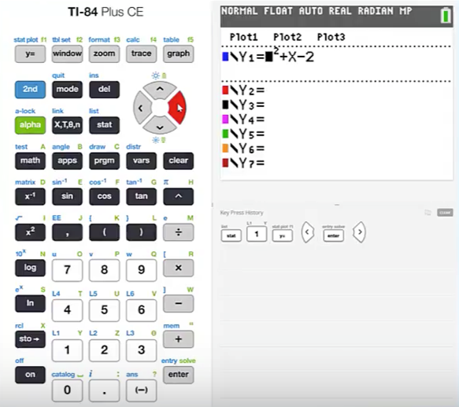
Histogram (5)
Note that the equal sign is no longer highlighted. This indicates that this function is turned off and will not be graphed.

Slide 10
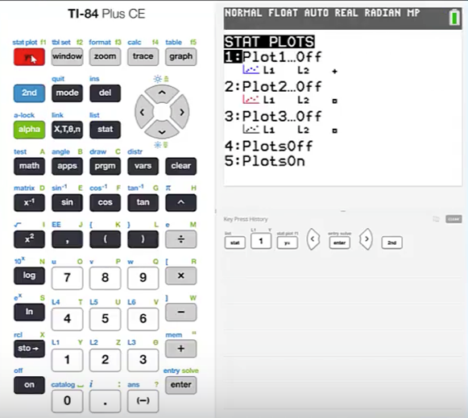
Histogram (6)
Note that the second function of the y equals button is stat plot. This calculator function allows us to create graphical displays of data such as a histogram.
Press 2nd stat plot

Slide 11
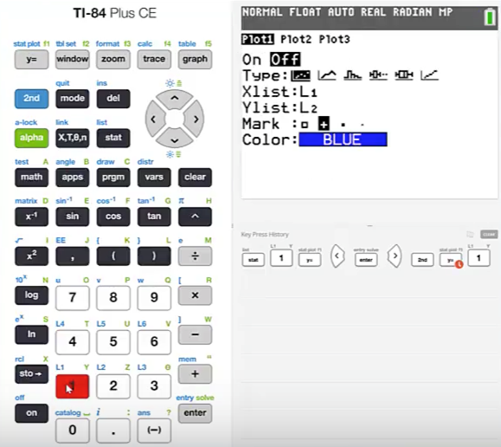
Histogram (7)
Access the first stat plot by pressing 1:
Begin by turning this plot On
Make sure the cursor is blinking on the On selection

Slide 12
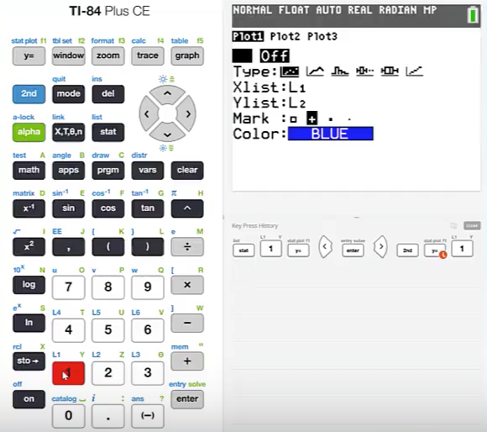
Histogram (8)
Make sure that the cursor is blinking on the On selection and press enter.

Slide 13
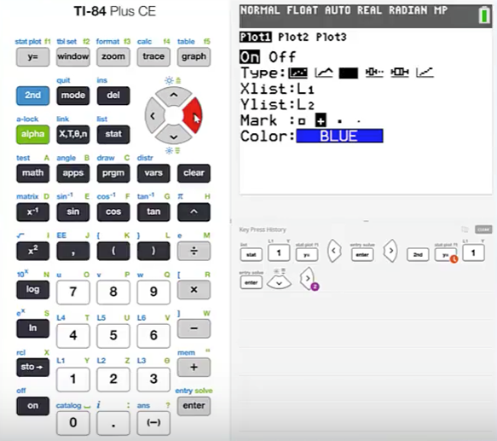
Histogram (9)
Cursor down
For Type cursor over and highlight the histogram icon and press enter.

Slide 14
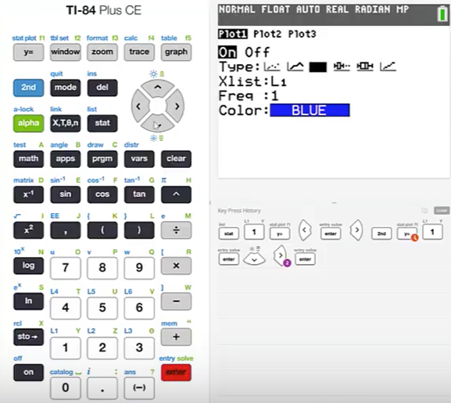
Histogram (10)
Cursor down and make sure the correct List is specified. Our data is in List 1.

Slide 15
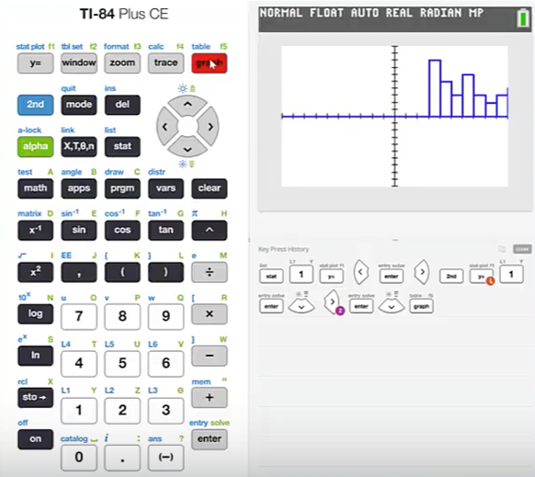
Histogram (11)
Press the graph button
Note that the display looks nothing like the histogram that we created by hand.
It is also apparent the entire histogram is not displayed and appears to be cut off on the right.

Slide 16
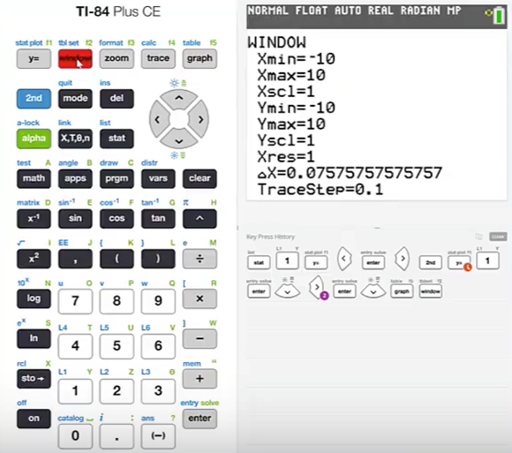
Histogram (12)
We need to set our window so the entire histogram is displayed correctly.
Press window

Slide 17
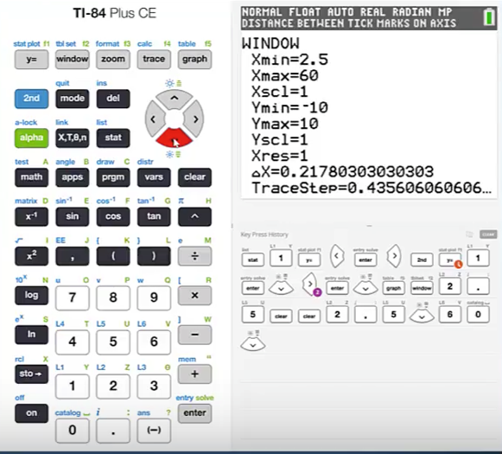
Histogram (13)
X minimum value is the lower bound of the first class which is 2.5
Cursor down to the maximum line. This should be set to the upper bound for the last class which is 58.5.
See slide 4 for boundary values.
Set the maximum value to 60. So the entire histogram appears on the screen.

Slide 18
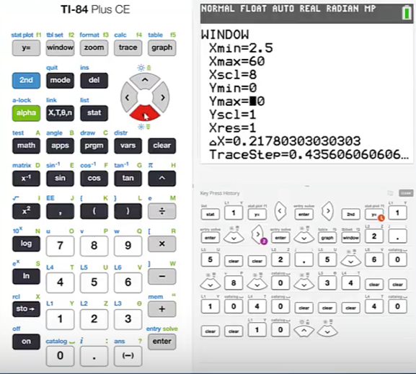
Histogram (14)
Cursor down to scale and enter the class width from the grouped frequency distribution.
The width was 8.
Cursor down to the minimum y value and set to 0.

Slide 19
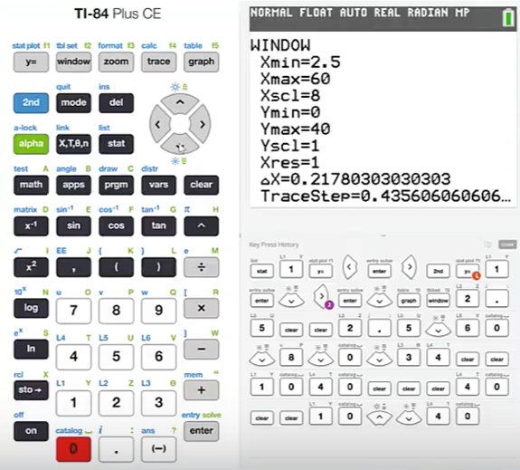
Histogram (15)
Cursor down to the Y maximum value and make sure that the value is greater than the largest frequency in the grouped frequency distribution.
The largest frequency in this grouped frequency distribution is in the first class and is 34.
Set the maximum Y value to 40. This value will ensure the entire histogram appears.

Slide 20
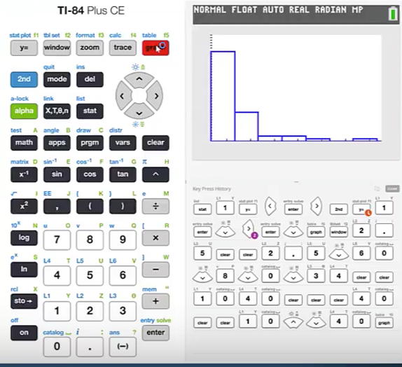
Histogram (16)
Press graph
This histogram now matches the one that we constructed by hand.

Slide 21
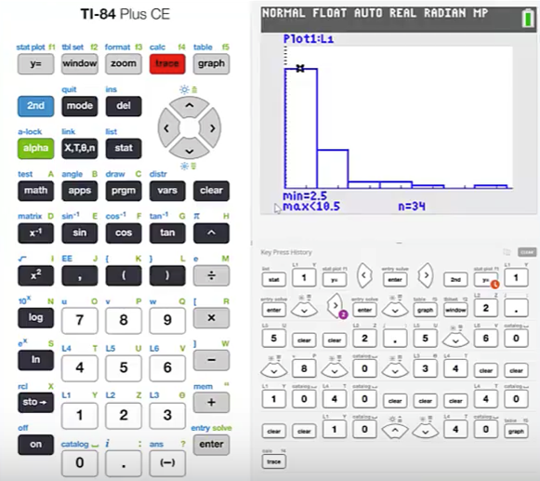
Histogram (17)
The calculator will display the lower and upper bounds and frequencies for each class by pressing trace.
Note the minimum and maximum values for the first class are 2.5 and 10.5 respectively.
Note the frequency is given as 34.

Slide 22
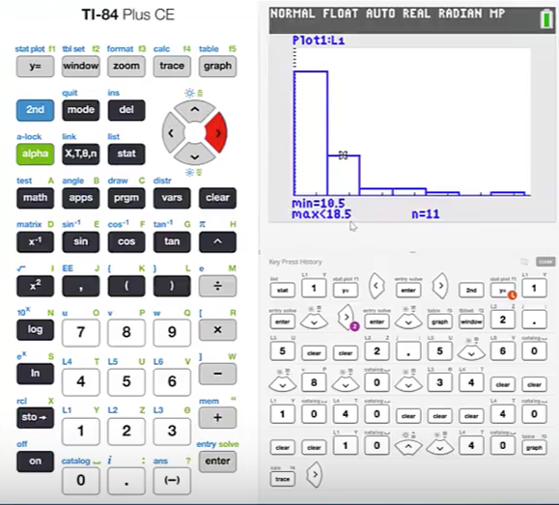
Histogram (18)
Press the right cursor to advance to the next class in the histogram.
Again the lower and upper bounds and frequency for that class are displayed.

Slide 23
Summary
In this PowerPoint we learned how to construct a Histogram using the TI Graphing Calculator.

Slide 24
Appendix of Image Long Descriptions

Slide 25
Data - Appendix
Starts with Alabama with 9, Alaska 3, Arizona 11, and eds with West Virginia 5, Wisconsin 10, and Wyoming. The values are 9,3,11,6,55,9,7,3,29,16,4,4,20,11,6,6,8,8,4,10,11,16,10,6,10.3.5,6,4,14,5,29,15,3,18,7,7,20,4,9,3,11,38,6,3,13,12,5,10,3
Jump to the image

